Slide 1
Short intro to Entra Agent Id
Marius Rochon

Slide 2
OWASP Agentic Threat | How Entra Agent ID Helps | Specific Agent ID / Entra Features | Coverage Assessment
1. Prompt Injection | Does not prevent injection, but can limit blast radius if an agent is successfully manipulated. | • Per‑agent identity isolation (Agent ID) • Permission scoping via Graph / APIs • CA‑enforced token restrictions | ⚠️ Partial Identity limits impact, not entry. Prompt injection must be handled at app / model layer.
2. Tool Misuse / Over‑permissioned Agents | Strong mitigation by enforcing least privilege at identity level. | • Agent‑specific identities (no shared app IDs) • OAuth scopes / app roles per Agent ID • Ability to disable or block Agent ID | ✅ Strong One of the best‑covered threats by Agent ID.
3. Unauthorized Delegation / Acting as the Wrong User | Prevents silent impersonation; enables explicit, auditable delegation only via agentUser. | • agentUser object as explicit delegate • CA evaluated for agent + delegate • Graph permissions enforced | ✅ Strong Direct mitigation of unauthorized “Act‑As” behavior.
4. Excessive Agent Autonomy | Limits what an agent can do, not how often it does it. | • Token lifetime enforcement • CA session restrictions • Ability to revoke tokens by disabling Agent ID | ⚠️ Partial Autonomy control is mainly an application orchestration concern.
5. Data Exfiltration via APIs | Reduces reachable data surfaces and enables network‑based blocking. | • CA Named Locations • Resource‑specific access tokens • Agent‑scoped API permissions | ✅ Moderate Effective for API‑based exfiltration, not model responses.
6. Cross‑Agent Lateral Movement | Strongly prevents lateral movement by default isolation. | • One Agent ID per copilot • No shared credentials • Independent CA targeting | ✅ Strong Identity isolation is the primary defense.
7. Credential Theft / Token Replay | Mitigates long‑lived or reusable credentials. | • Short‑lived client‑credentials tokens • CA evaluation at token issuance • Sign‑in logs for agents | ✅ Strong Comparable to mature workload identity security.
8. Agent Supply‑Chain Attacks (malicious plugins) | Does not detect malicious logic, but prevents it from inheriting broad trust implicitly. | • No automatic trust between agents • Explicit consent required for permissions | ⚠️ Partial Supply‑chain validation is outside identity scope.
9. Insufficient Agent Accountability / Logging Gaps | Strongly improves attribution and auditability. | • Agent‑specific sign‑in logs • CA + Entra audit logs • Distinct principal per agent | ✅ Strong Major improvement over shared app identities.
10. Human Trust Abuse ( | No direct mitigation. Identity does not influence user trust decisions. | • None (identity layer only) | ❌ Not mitigated This is a UX, policy, and training problem.

Slide 3
Artifacts
Entra objects
  agentIdentityBlueprint
  agentIdentity
  agentUser
OAuth2 flows
  New parameters on Client Creds
  New token claim
Conditional Access
  Target specific agents or collections of agents
  Use agent security attributes
  Non-human interactions
Portals
  Entra
  M365 Admin
APIs/SDKs
  MS Graph
  Agent365 SDK/CLI
  Entra SDK for Agent ID

Slide 4
agentIdentityBlueprint
Extension of Application and Service Principal objects:
  inheritablePermissions/inheritableScopes
  sponsors/owners
Container of permission definitions and security attributes
Provisioned automatically: Foundry for each project, CopilotStudio - one for the tenant
…or, via Agent365 SDK/CLI or MS Graph
Provisions agent instances with identities and runtime privileges
Show shape

Slide 5
agentIdentity
Extension of ServicePrincipal – similar to multi-tenant apps
A blueprint may define any number of agentIdenties
Blueprint defines max permissions envelope
Credentials managed by blueprint
Analogy:
  Blueprint – host
  Entra – receptionist
  AgentId - visitor

Slide 6
agentUser
Extension of user object
Credentialled by blueprint and agentIdentity
Use for scenarios where agent needs to be like a human user, e.g. mailbox delegate, i.e. does not require human presence
Serves different scenarios than OBO (requires a human)
Took four conversation turns to correct Copilot’s hallucinations!
  “There is no object called agentUser”
  “agentUser does not use tokens”
Analog: AgentIdentity ‘puppet’

Slide 7
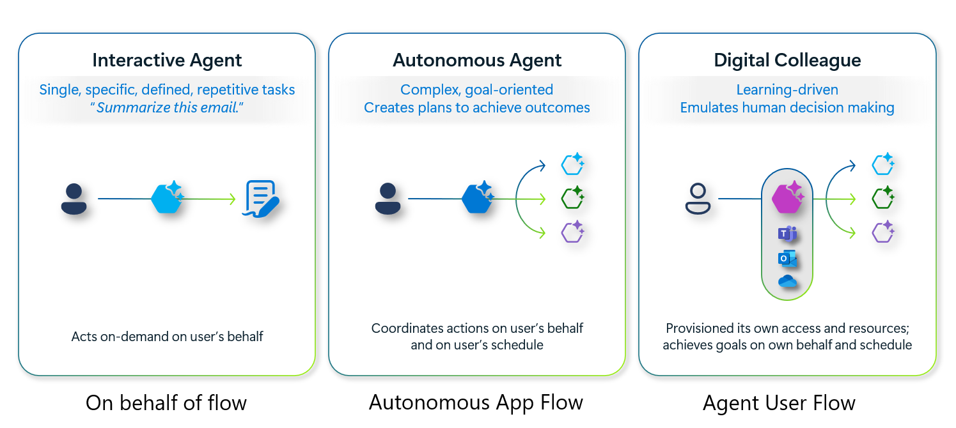
Entra Agent ID Scenarios
Notes:
https://learn.microsoft.com/en-us/entra/agent-id/identity-platform/agent-oauth-protocols#oauth-protocols

Slide 8
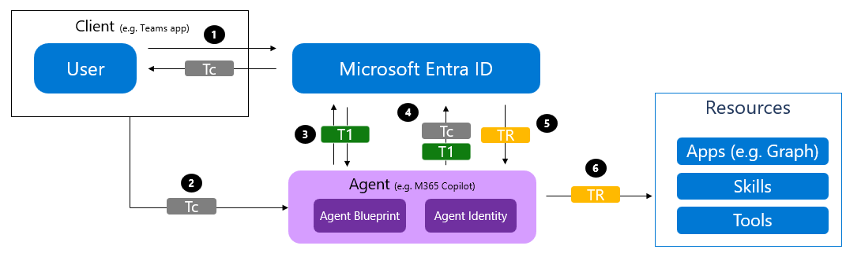
OBO agent

Slide 9
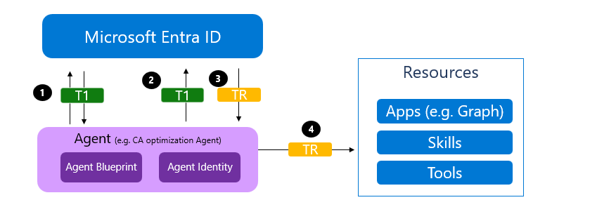
Autonomous agent

Slide 10
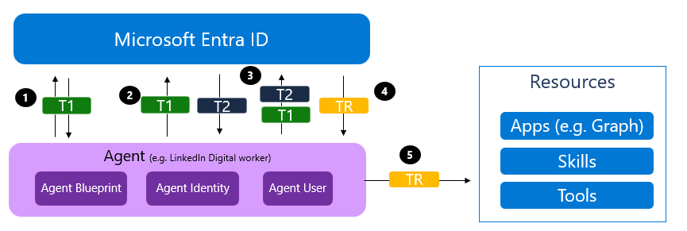
agentUser token acquisition

Slide 11
Demo
Agent Identity Token Tester

Slide 12
Resources
https://github.com/microsoft/Agent365-samples
https://github.com/microsoft/entra-agentid-samples
https://github.com/mrochon/AgentIDSamples shows:
  Graph creating blueprints/agentIds
  Host executing token acquisitions

